Slide 1
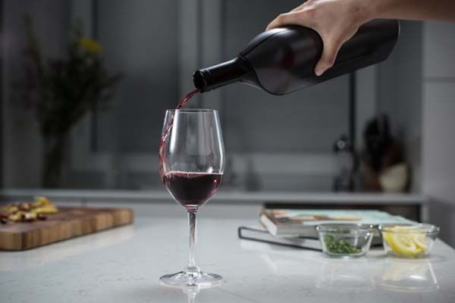
THE BATTLE OF THE NEIGHBORHOODS (Best Location for to Open a New Wine Shop in Paris)
This is my capstone project for my IBM Data Science course on Coursera

Slide 2
Introduction / Business Problem
Locations for a New Wine shop in High Traffic Areas in Paris France
A successful Online wine shop wants to go into retailing to own a physical store where they can entertain customers and give them a taste of the wine before the customers can buy.
According to their market survey, they are planning to launch a new brand of wine and they figured out if people get to taste the wine first they will prefer it to wines from other competitors. But being an e-commerce guru with only online presence, there is no way they can get people to taste the new set of wines and also to entertain people.
As a data scientist, I have been given the task to analyze all locations in Paris and provide which is the best location for them to open this wine shop. I am to leverage on existing data to help them make a good data-driven decision on which location has the highest traffic in Paris.
I will be leveraging on Foursquare Location data to help me provide the required solution and help the company in making data-driven decisions about the best location to launch from.

Slide 3
Criteria
According to some qualitative data analysis online, they suggest that the best location to open a new wine shop might not be where other wine shops are, but locations where there are Restaurants, Cafes and Bars. A location where people go to socialize a lot and frequently, so opening a wine shope in that location might just be the best.
Narrowing down the data to the best district options derived from qualitative analysis allows for either further research to be conducted on people taste, or physical searching for specific location by the company.
Why Data?
Without using data to make decisions about the best location for a new wine shop, the company could spend countless hours walking around, consulting clubs and party goers who will only give them advise based on their person preference, and they might end up opening in a location that is not ideal.
Data will provide better answers and better solutions to their task at hand.
Outcomes
The goal is to identify the best location - Arrondissements - to open new wine shop as part of the company's plan to launch new brands of wine. The results will be sold to the management in a basic form that will help the data-driven analysis for the best locations to open the wine shop.

Slide 4
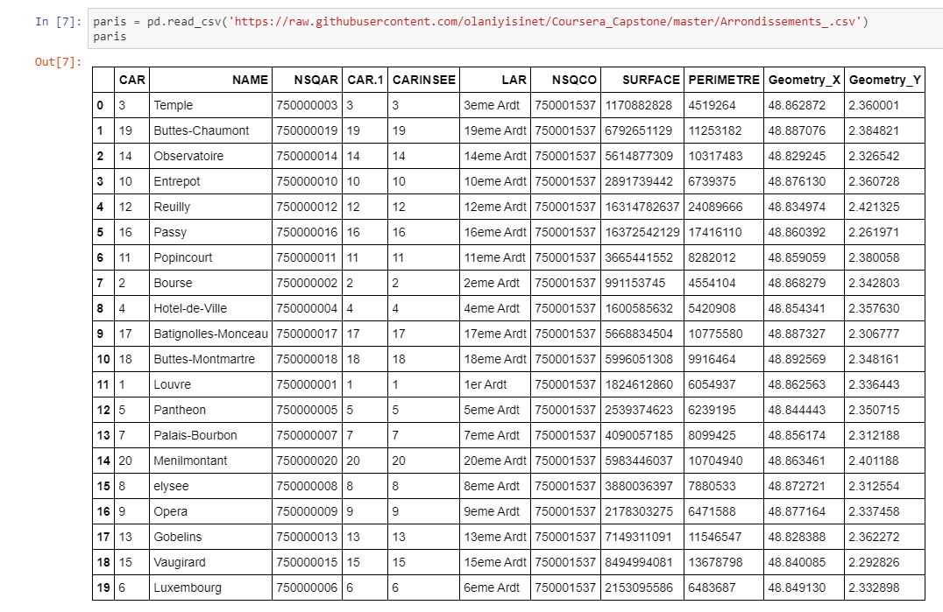
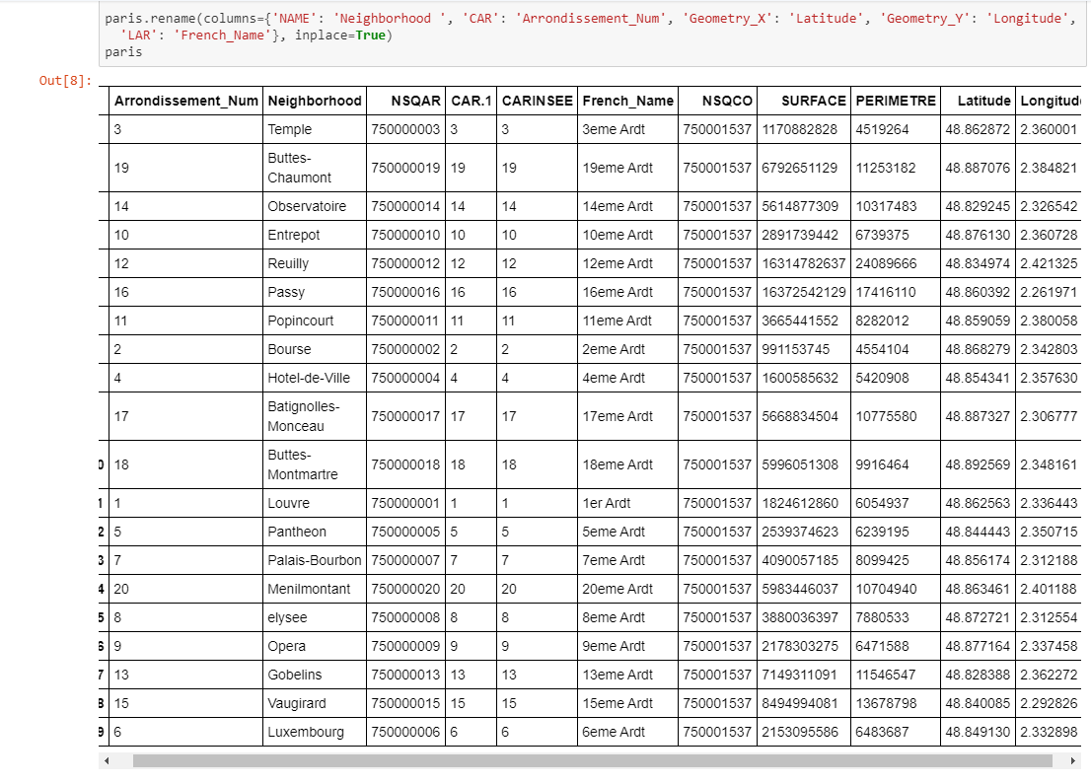
Importing Paris District Data
Paris is divided into 20 Arrondissements Municipaux (or administrative districts), shortened to just arrondissements. They and normally referenced by the arrondissement number rather than a name. This data is necessary to select the best location for this wine shop.

Slide 5
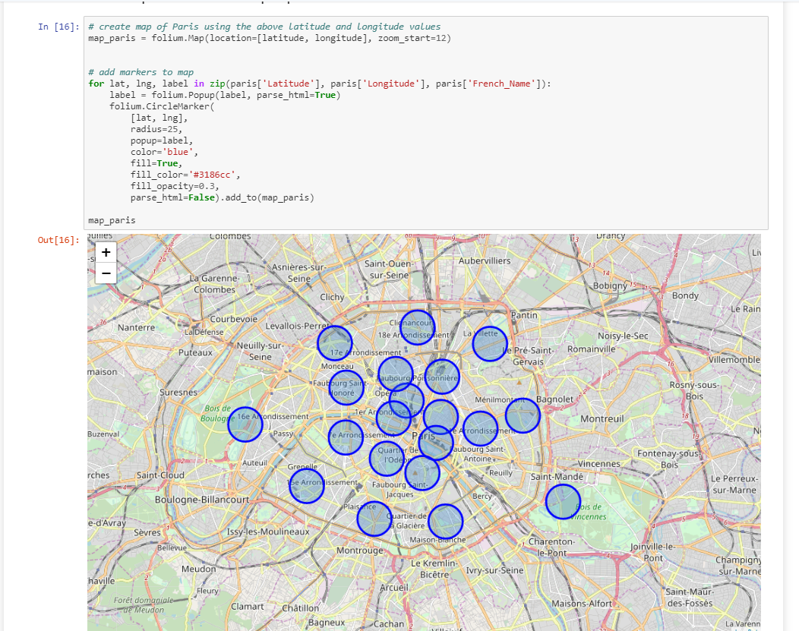
Data Analysis and Location Data
Showing the map of Paris with the 20 locations

Slide 6
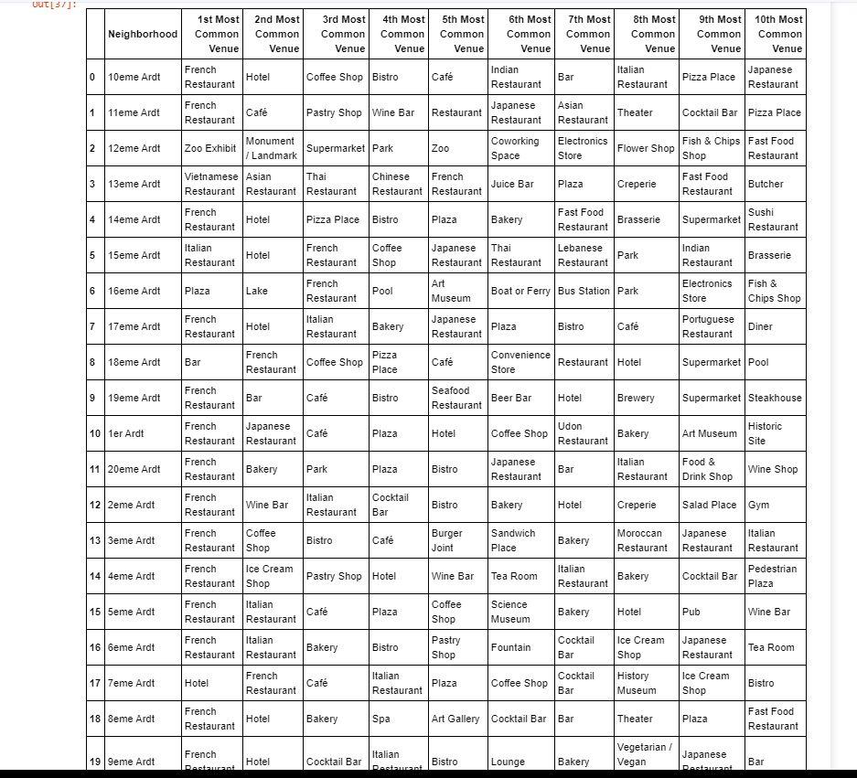
Location and Venues in the Neighborhood

Slide 7
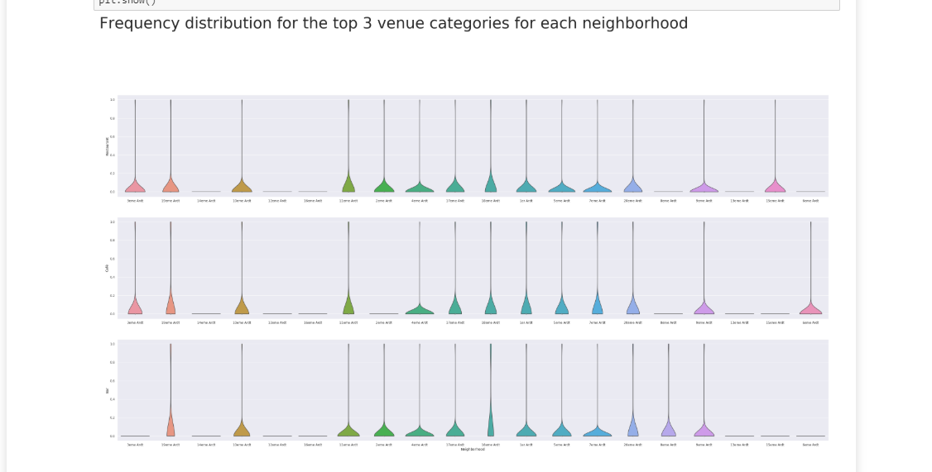
Selecting Neighborhood that fits our criteria
(Restaurant, Café, and Bars)

Slide 8
Selecting Neighborhood that fits our criteria
(Restaurant, Café, and Bars)

Slide 9
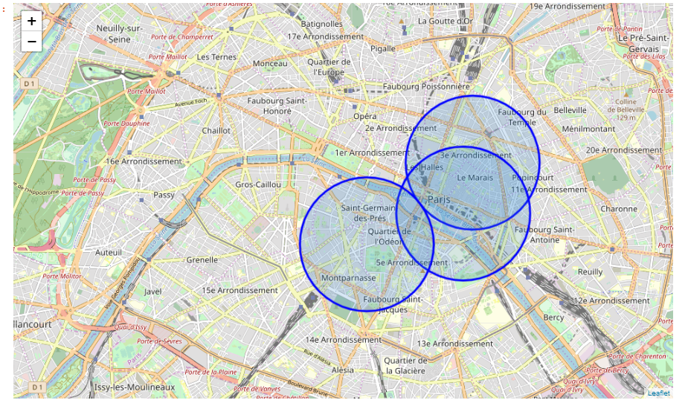
Three best Locations that fits our criteria

Slide 10

Influence & Conclusion
Not a surprise that these districts are all very centrally located in center of Paris's arrondissements. Locations for wine shops and nice wine bars will be fitting the criteria for popular venues where people will like to go and have all the fun in one place, it would be the same in many cities of the world.
The business owners can test my models with different locations to see how it works and also provide feedback for proper improvements.

Slide 11
Thank You

